Slide 1




Effective Feature Engineering:
A Structured Approach to Building Better Machine Learning Models
Dipanjan Sarkar
22 – 25 November, 2018
NIMHANS Convention Center, Bengaluru

Slide 2
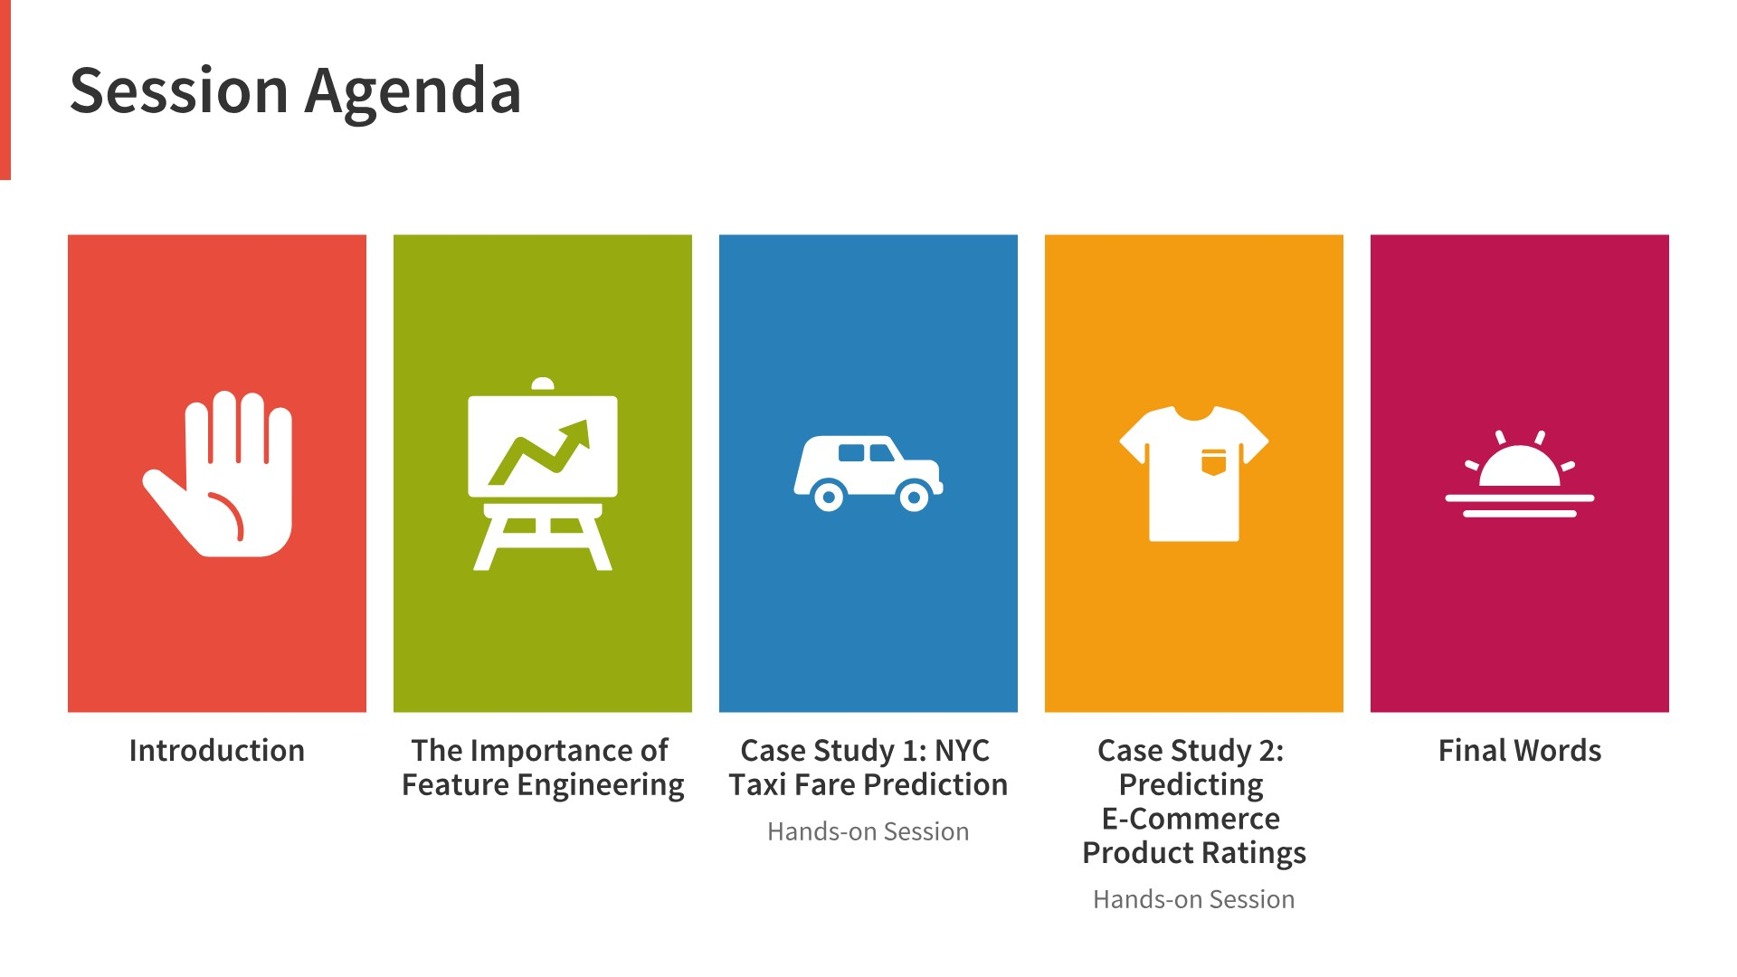

Slide 3
http://bit.ly/dhs18_ds

Slide 4


Slide 5


Slide 6
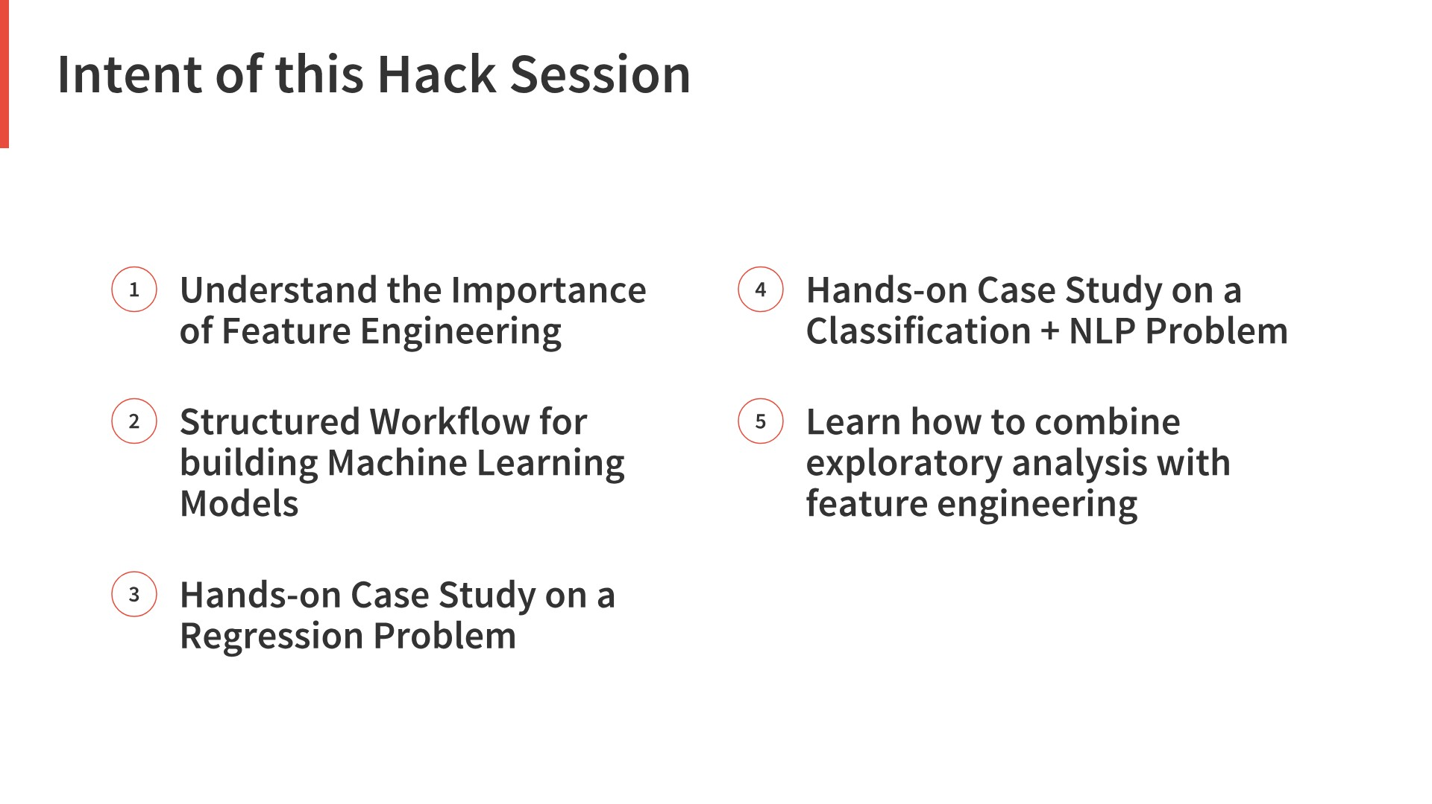

Slide 7


Slide 8
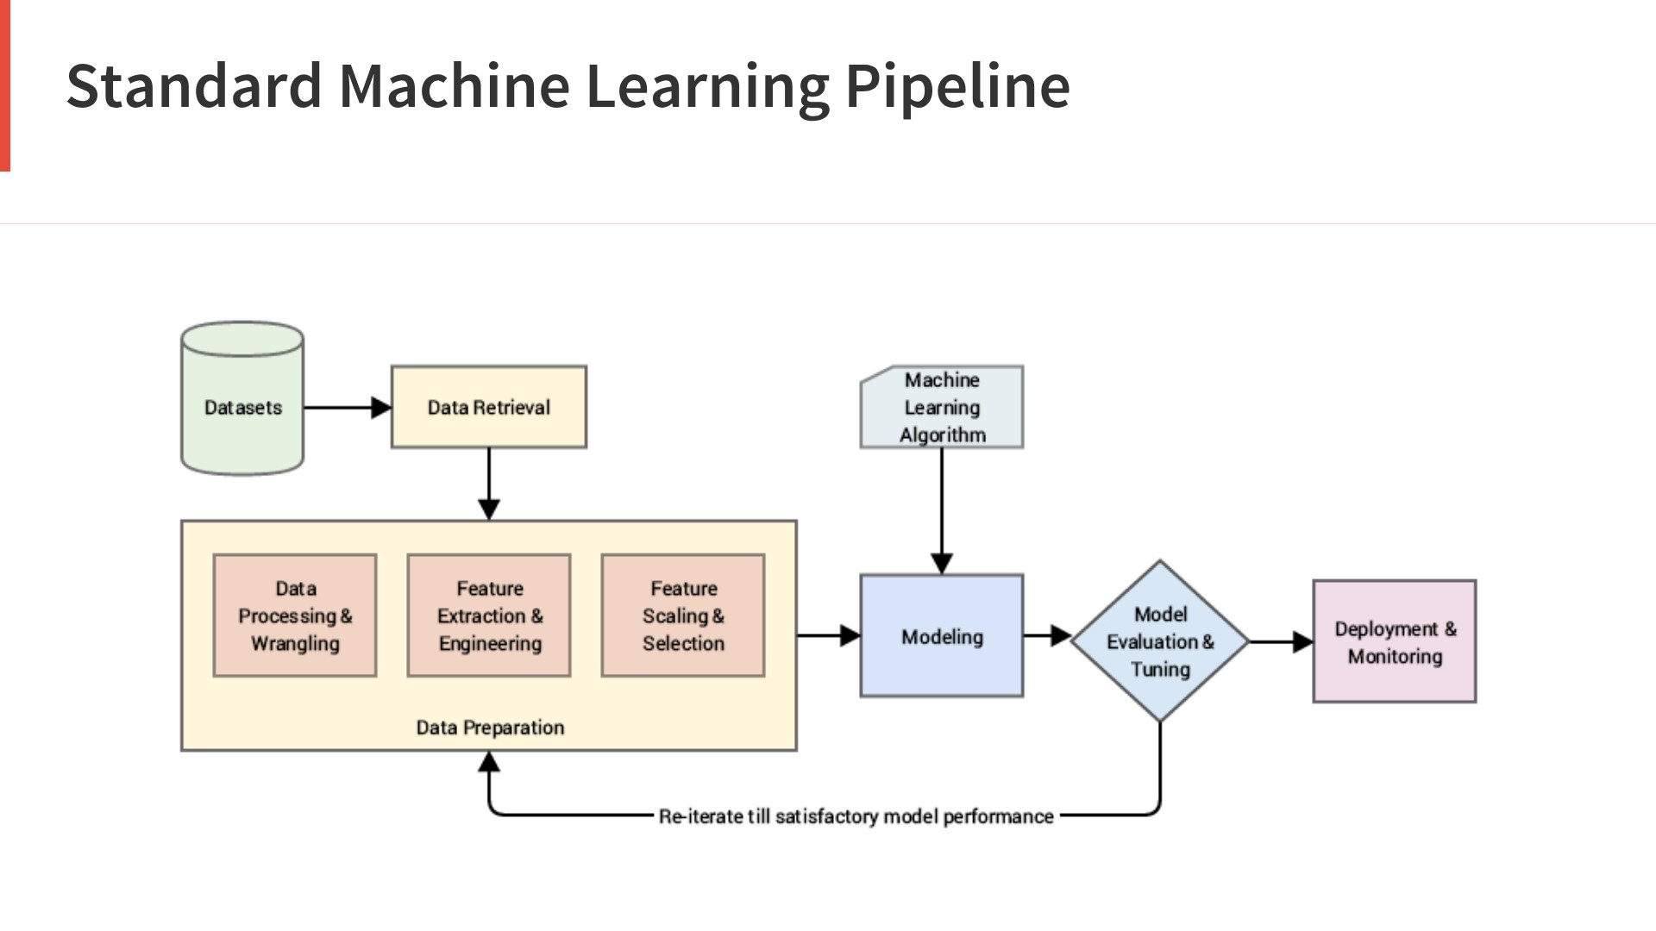

Slide 9
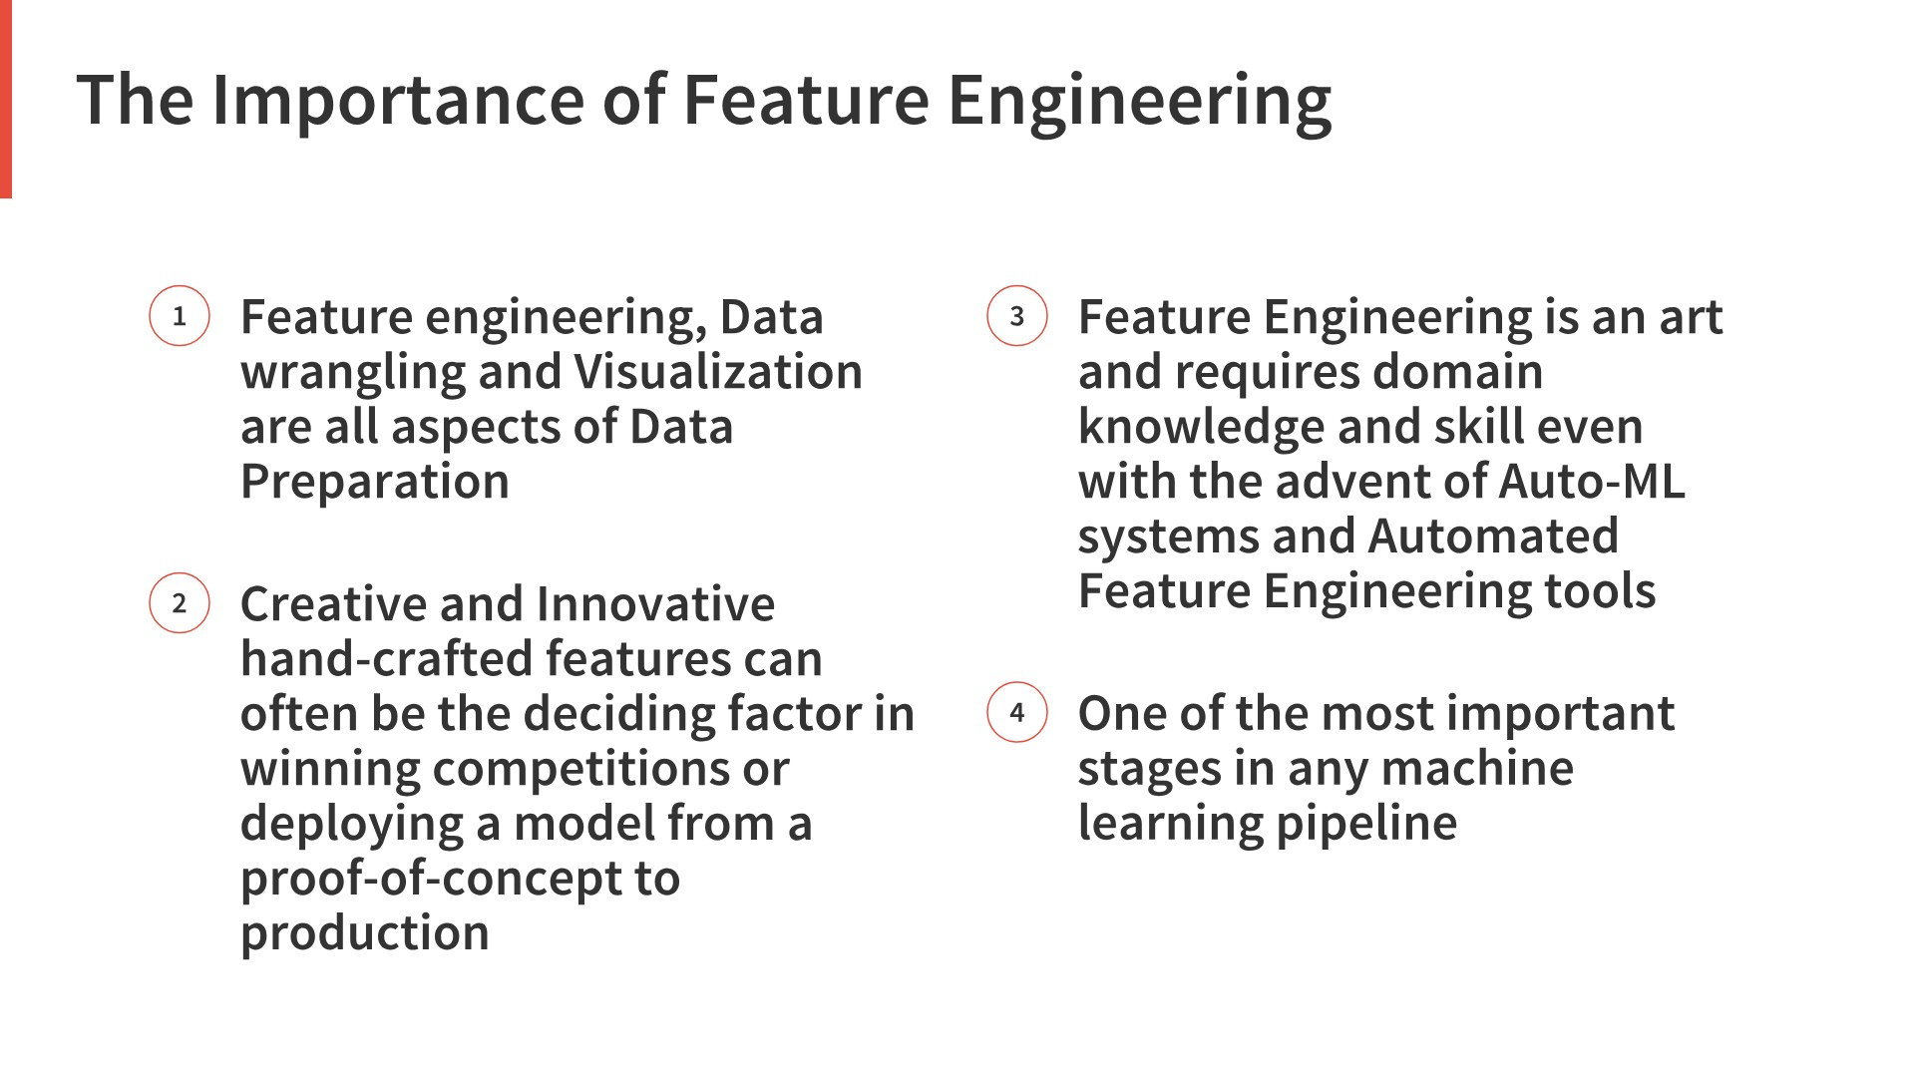

Slide 10
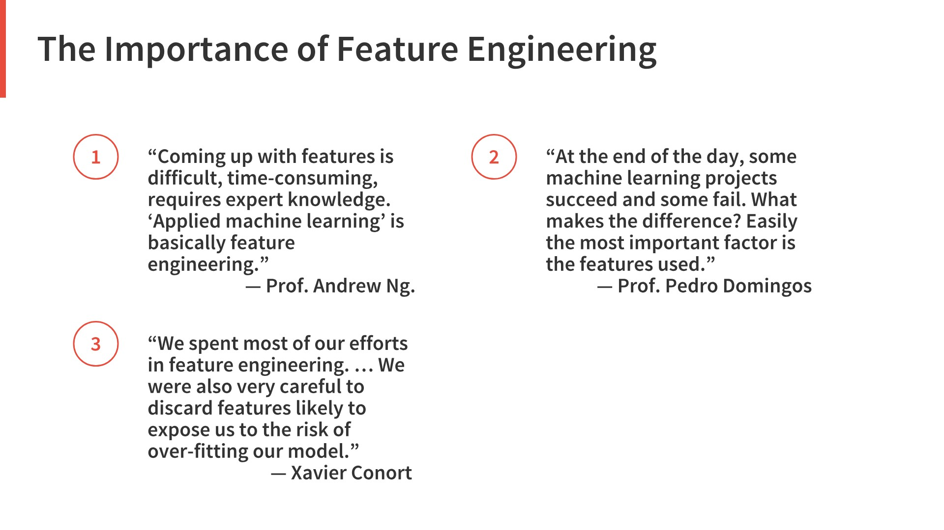

Slide 11


Slide 12


Slide 13


Slide 14
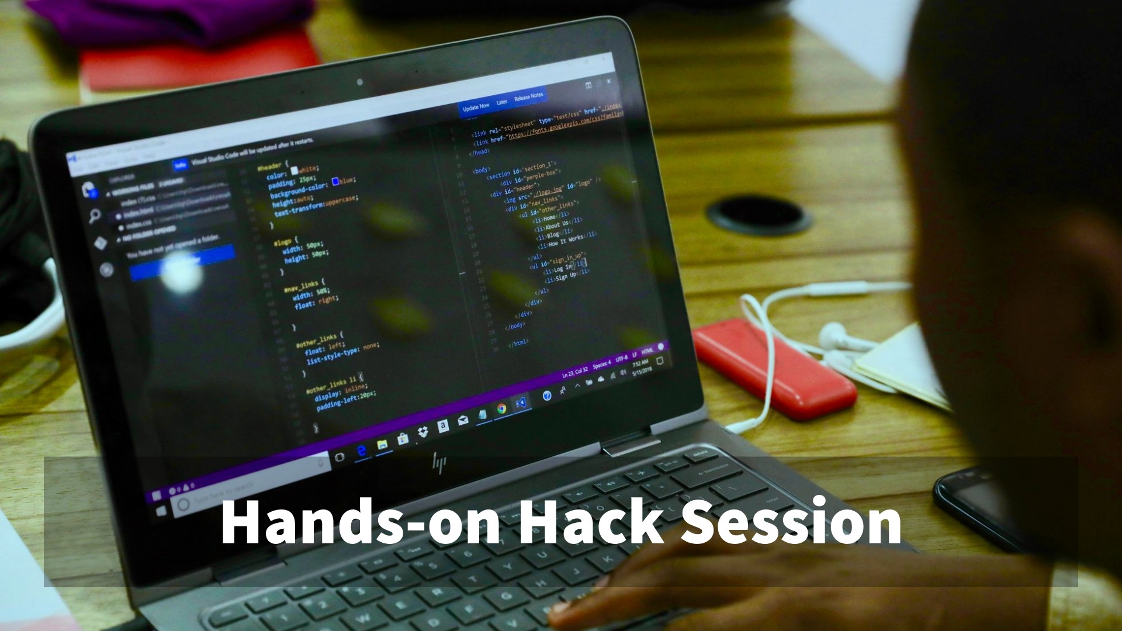

Slide 15


Slide 16
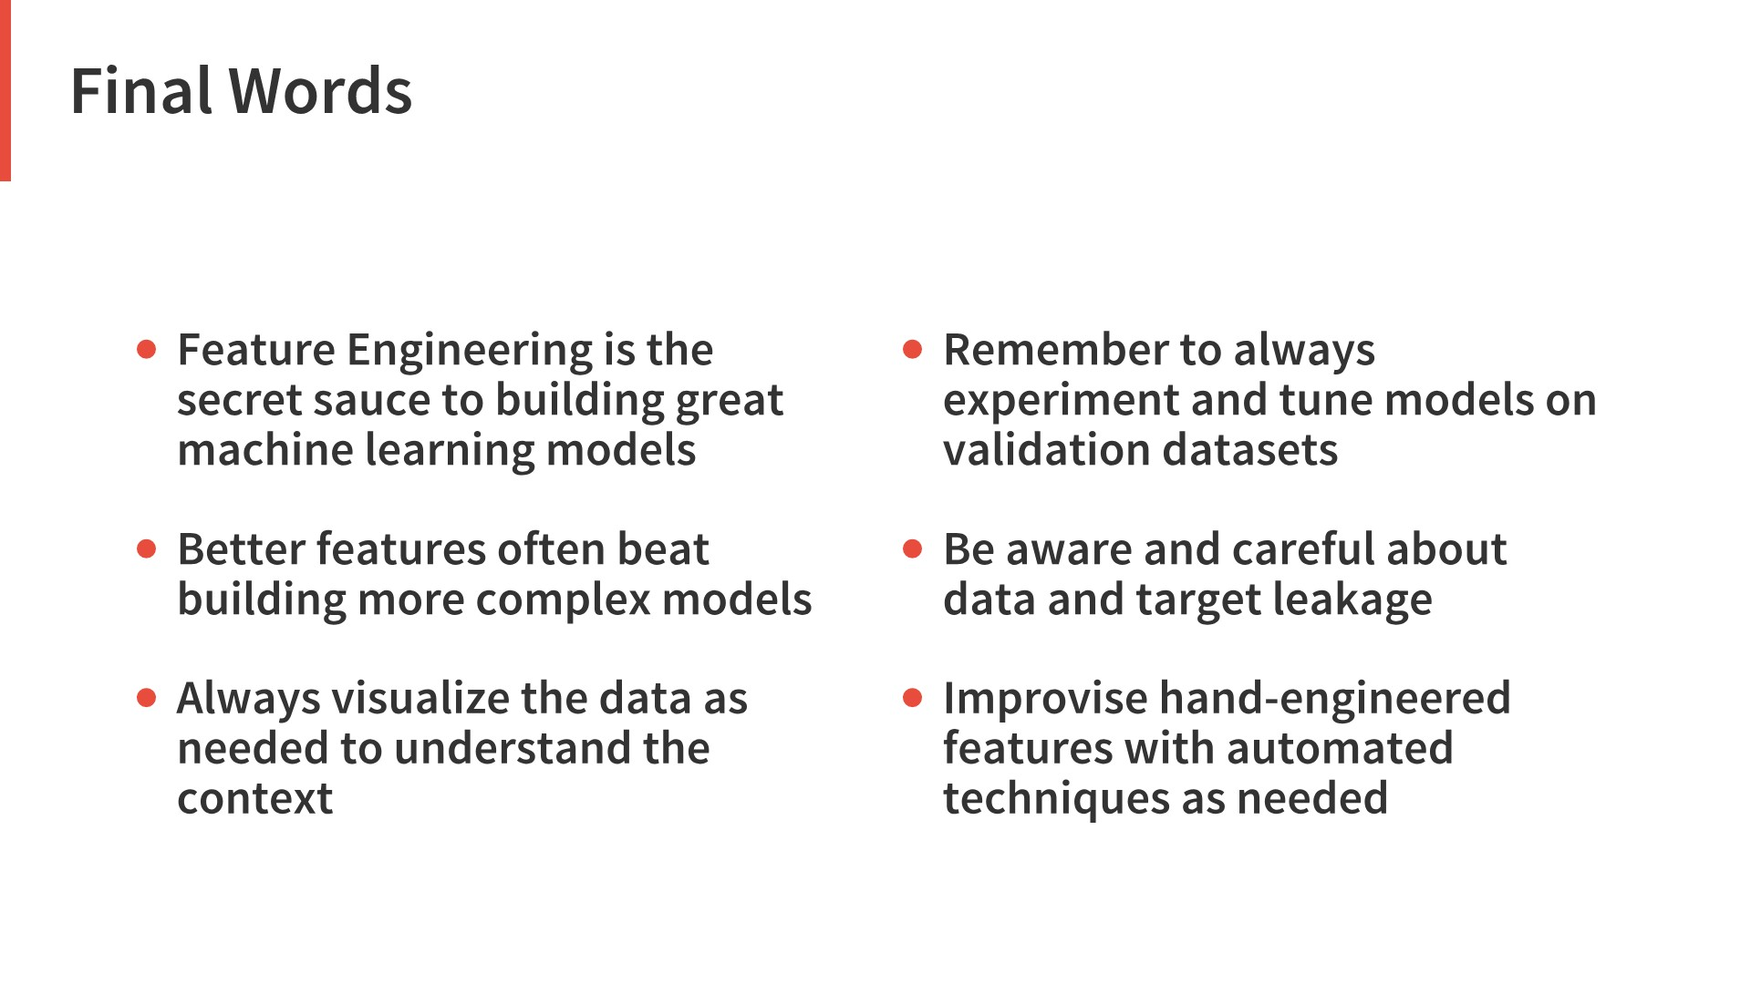

Slide 17
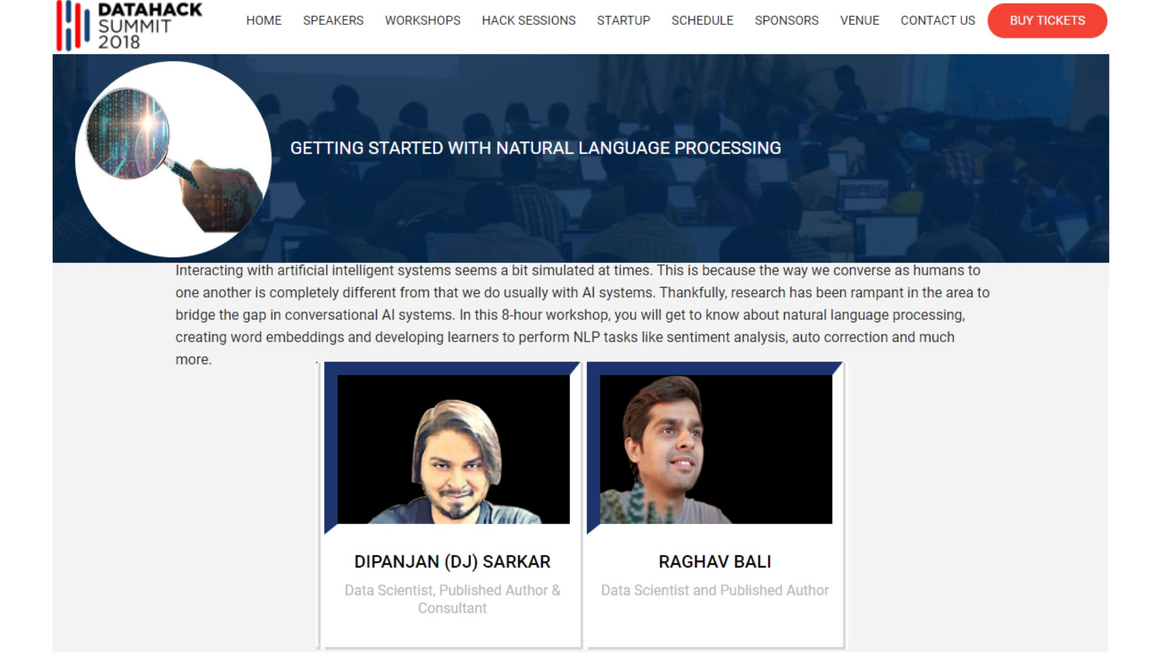

Slide 18


Slide 19
Contact Us For Tickets
Thank You

